Slide 1

H1 VISA VISA Status Prediction using Machine Learning Models
SAI Charan GADIRAJU
RC32296
DATA 606- Capstone Project
under guidance of Dr. Chaojie Wang

Slide 2

CONTENT
Introduction
Data Source
Pre-Processing
Exploratory Data Analysis
Machine Learning models
Conclusion

Slide 3

INTRODUCTION
H-1B Visas Overview
Employment-based, non-immigrant visas for temporary foreign workers in the US.
Requires a job offer from a US employer and a visa petition to the US immigration department.
International Students' Choice
Most common visa for international students transitioning to full-time positions.

Slide 4
Stay Duration
Initial: 3 years, extendable to 6 years; potential reapplication afterward.
Annual Cap
Statutory cap: 65,000 visas annually.
Additional 20,000 for US master’s or doctorate graduates

Slide 5

DATA SOURCE
Data Provider: Kaggle (US Department H-1B Visa Petitions 2017 – 2022)
Data Description: The data consists of disclosure files, covering labor certification for US employers hiring foreign workers for permanent positions.
The dataset consists of last six years information from 2017-2022
Data Size: 454.7+ MB
Number of rows: 3973349
Number of columns: 14
Each row describes applicant information.

Slide 6
DATA DICTIONARY
Visa_Class | It typically refers to the category or type of visa that an individual is applying for H-1B.
Employer_name | Legal business name of employer requesting permanent labor certification.
SOC_Title | It refers to the Standard Occupational Classification (SOC) title, which is a standardized system used to classify and categorize occupations in the United States.
Job_Title | It refers to the specific designation or title associated with a particular employment position held by an individual
Full_Time_Position | It typically denotes whether a job or position is designated as a full-time role, indicating that the employee is expected to work a standard number of hours per week, usually 35-40 hours, depending on the organization's policy.
Worksite | "Worksite" refers to the physical location or geographical site where an employee performs their job duties.
Prevailing_Wage | "Prevailing Wage" is the average wage paid to similarly employed workers in a specific occupation in a particular geographic area, as determined by the U.S. Department of Labor.
Unit_of_Pay | It refers to the measurement or basis used to specify the compensation for a particular job, such as hourly, weekly, monthly, or annually.
Employer_Location | It refers to the geographic location or address where the employer's main office or headquarters is situated.
Employer_Country | It refers to the country where the employer is based or headquartered. It signifies the home country of the organization submitting the visa application.
Case_status | Status associated with the last significant event or decision. Valid values include “Certified”, “Certified-Expired”, “Denied”, and “Withdrawn”.
Year | It indicates the year of applications.

Slide 7
DATA PRE-PROCESSING – CHECKING NULL VALUES
Quarter column has only values as Q1,Q2,Q3, and Q4, hence dropped ‘Quarter’
Dropped null values for other columns.

Slide 8

EXPLORATORY DATA ANALYSIS

Slide 9
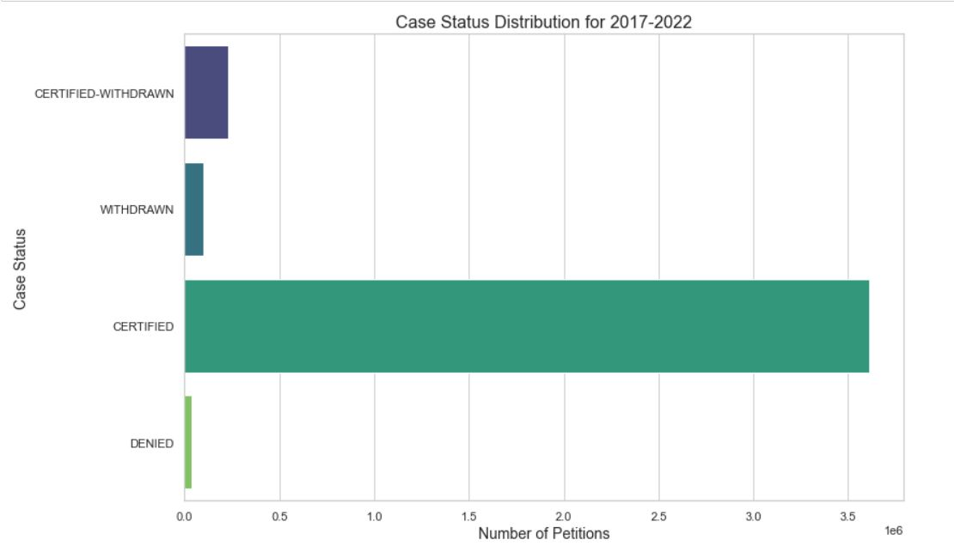
1. NUMBER OF PETITIONS PER CASE STATUS

Slide 10
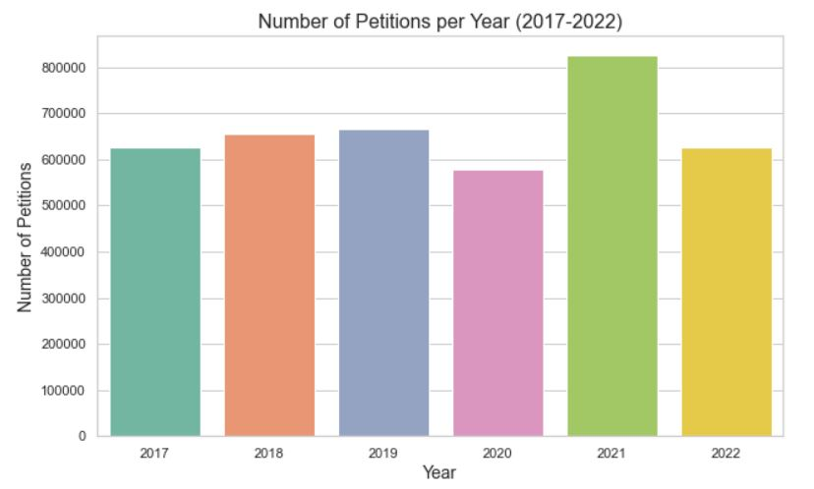
2. TOTAL NUMBER OF APPLICATIONS PER YEAR
The year 2021 has the highest number of applications '826305'.
Almost for the year 2022, 2019, 2018, and 2017 the number of applications are same.
The least is in the year 2020, maybe there can be few reasons as one of them is COVID pandemic.

Slide 11
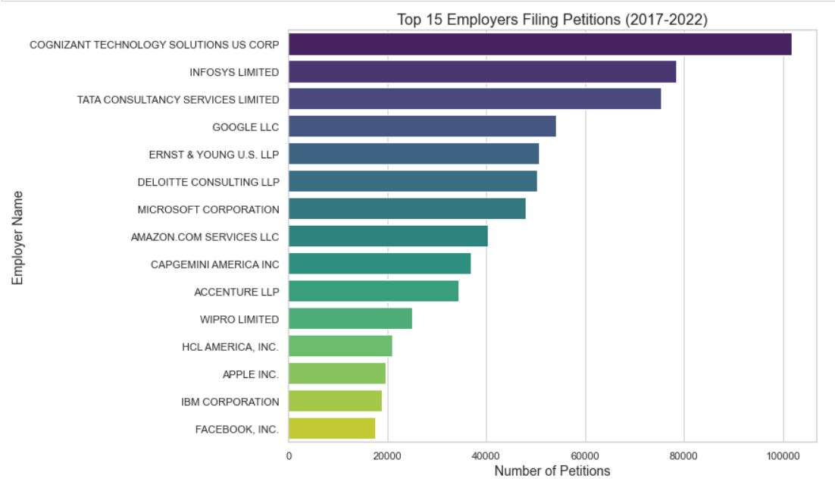
3. THE TOP 15 EMPLOYERS FILING THE H1-B VISA PETITIONS
Cognizant, Infosys Ltd, and Tata Consultancy are among the Top 3 employers filing for H1B.
Also the Top Giant - Google, Amazon, and Microsoft filed more than the average petitions.

Slide 12
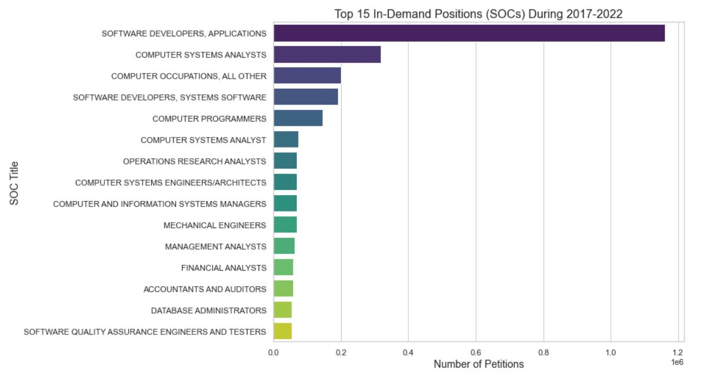
4. THE TOP 15 SOC NAMES FOR WHICH H1-B VISAS ARE RAISED

Slide 13
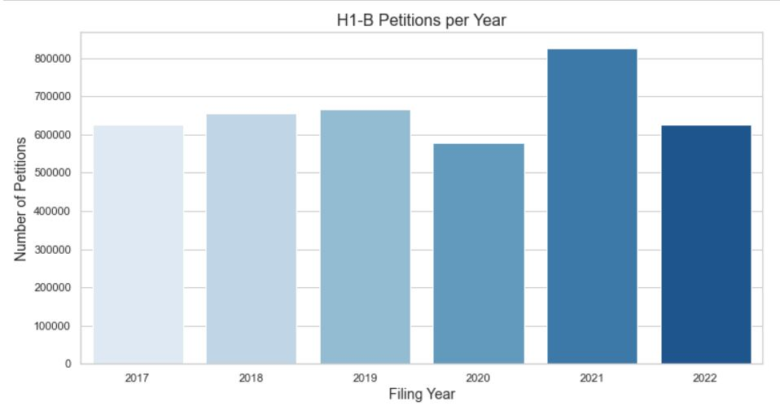
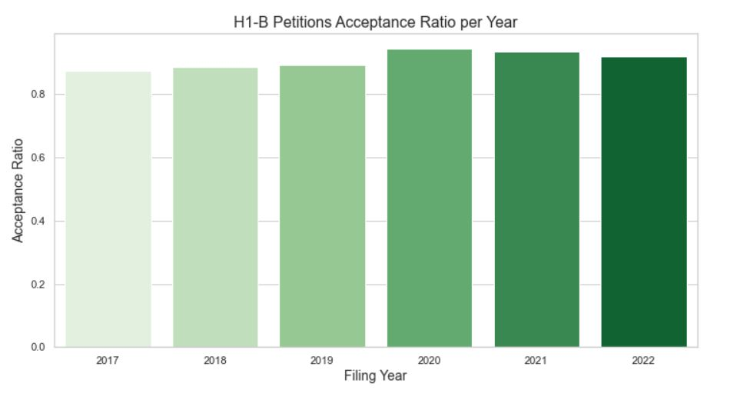
5. ACCEPTANCE RATE OF THE H1-B VISA PETITIONS THROUGH DIFFERENT YEARS

Slide 14
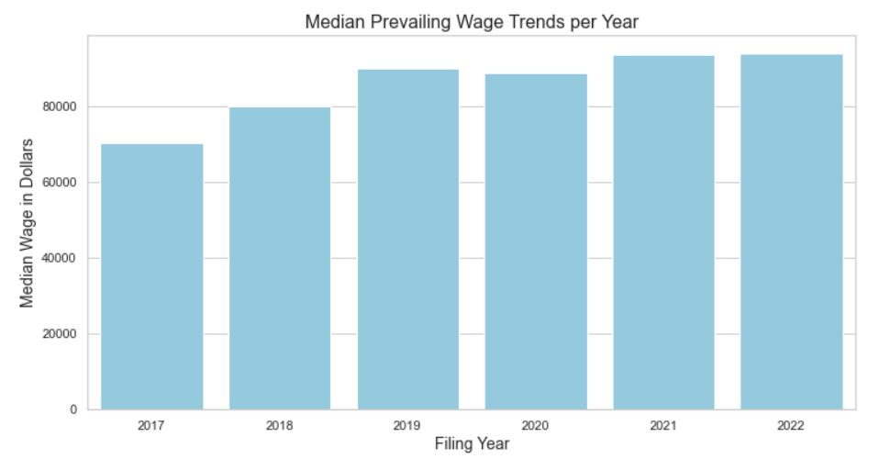
6. SALARIES TREND PER YEAR

Slide 15
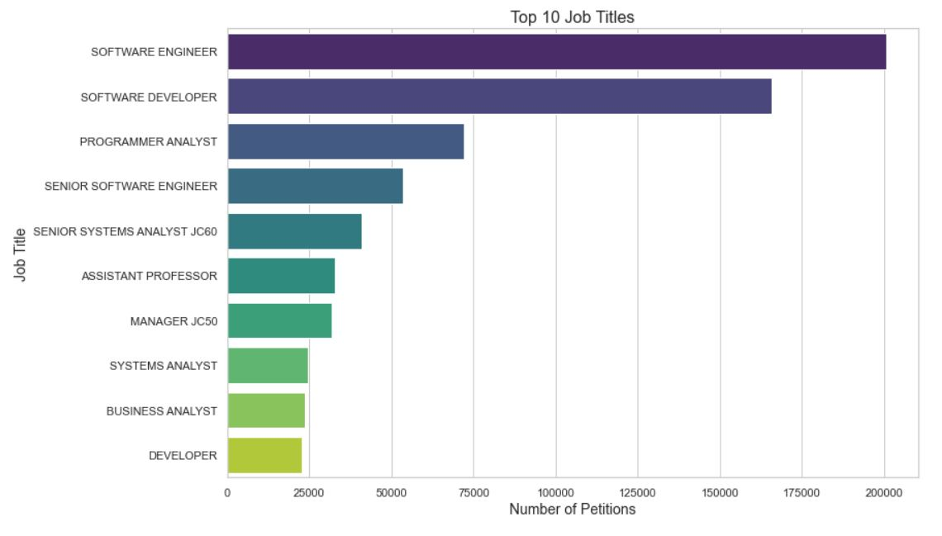
7. TOP JOB TITLES

Slide 16
8. NUMBER OF APPLICATIONS FOR THE FULL TIME POSITIONS

Slide 17

MACHINE LEARNING MODELS

Slide 18
Features
YEAR
WORKSITE
WAGE_CATEGORY
EMPLOYER_ACCEPTANCE
JOB_ACCEPTANCE
SOC_ACCEPTANCE
FULL_TIME_POSITION
Target Value
CASE_STATUS
‘CERTIFIED’
‘Certified-Expired’
‘DENIED’
‘Withdrawn’

Slide 19
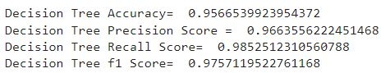
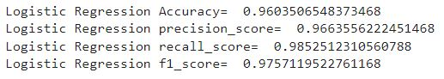
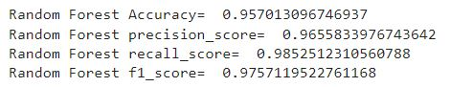
CLASSIFICATION REPORT
1. Decision Tree
2. Logistic Regression
3. Random Forest

Slide 20
CONCLUSION
Petition Distribution (Case Status):
Certified: 3,611,457 petitions, Certified-Withdrawn: 227,347 petitions, Withdrawn: 100,097 petitions, Denied: 34,448 petitions
Application Trends:
Peak in 2021 with 826,305 applications
Consistent numbers for 2022, 2019, 2018, and 2017
Decrease in 2020, attributed to the COVID-19 pandemic
Top Employers:
Cognizant, Infosys Ltd, Tata Consultancy lead in filings
Tech giants (Google, Amazon, Microsoft) exceed average petitions
Occupation Trends:
Software Developers in high demand
Clear shift toward IT-related positions
Petition Numbers:
Generally increasing annually (except 2020)
Exceptional 2021 with almost 800,000 petitions
Acceptance ratio consistently above 80%
Wage Analysis:
Median wage increases yearly (except 2022)
Notable decrease in 2020
Overall trend reflects salary growth
Top Job Titles:
Software Engineer and Software Developer dominate
Information Technology fields dominate the top 10
Classifier Accuracy:
Random Forest, Logistic Regression, and Decision Tree exhibit consistent 96% accuracy

Slide 21
Thank you

